Slide 1
Systems Biology of Human Metabolism and Gut Microbiome 2020
February 17-21, 2020
Science For Life Laboratory (SciLifeLab)
Stockholm, Sweden

Slide 2
Welcome to The Course!!

Slide 3
Course Website
Main information portal
Will be updated often
Materials
Workshops
Data
Etc
Materials will be uploaded maximum 2 hours after the lectures
http://sysmedicine.com/phd2020

Slide 4
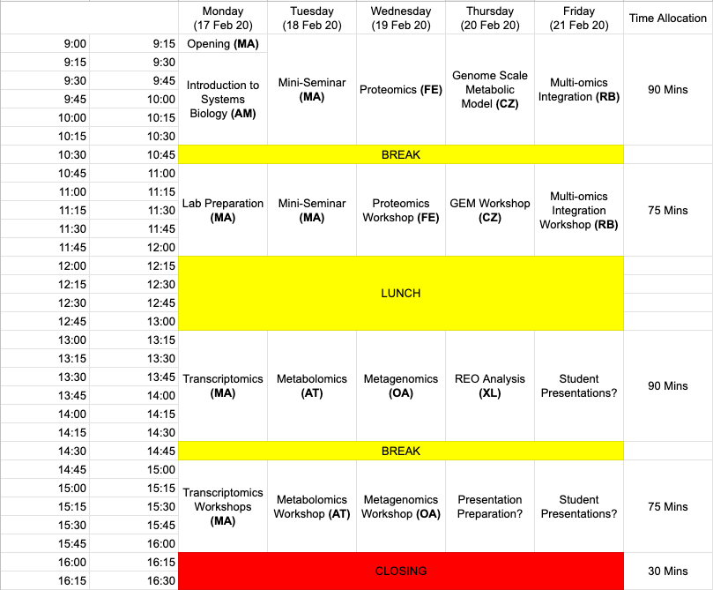
Schedule

Slide 5
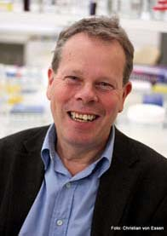
Mini-Seminar
Prof. Lukas Käll
(KTH)
Prof. Mathias Uhlén
(KTH)
Dr. Saeed Shoaei
(King’s College London)

Slide 6
Other Practicalities
Lunch will be provided in the restaurant nearby
Nanna Svartz (Aula Medica)
Please make sure that you have the coupons
Dietary restrictions has been provided to them
Fika will also be provided
Around 14:30ish
Coffee, Tea, Bakeries

Slide 7
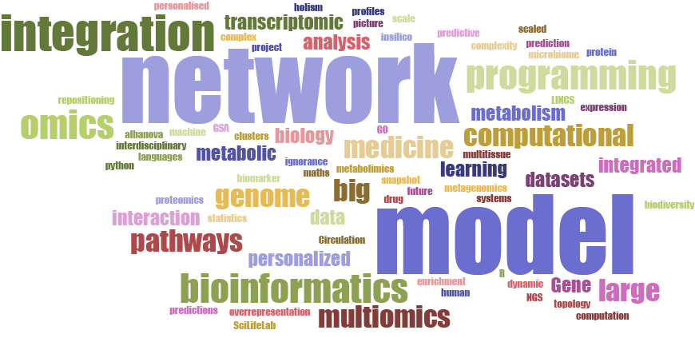
Keywords

Slide 8
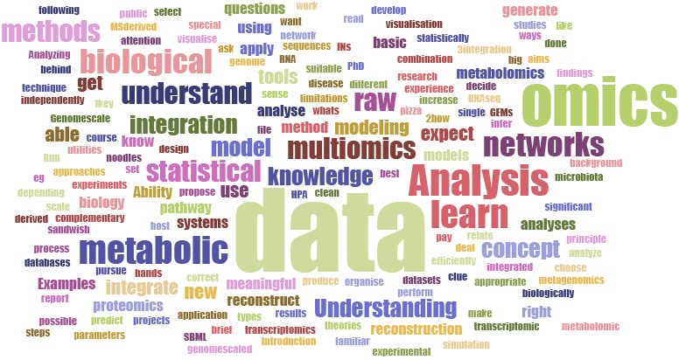
Motivations

Slide 9
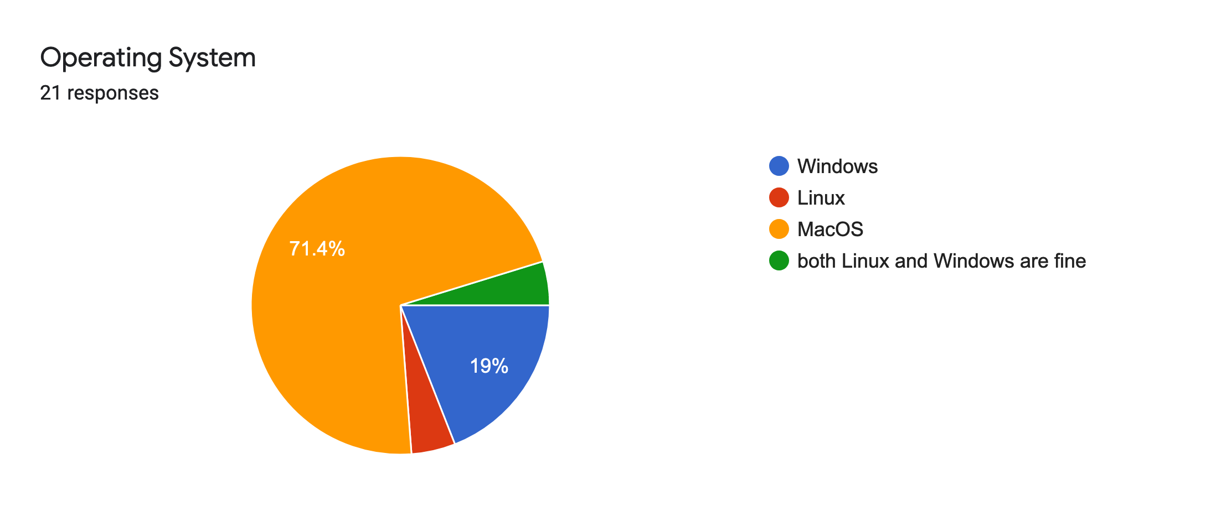
Operating Systems

Slide 10
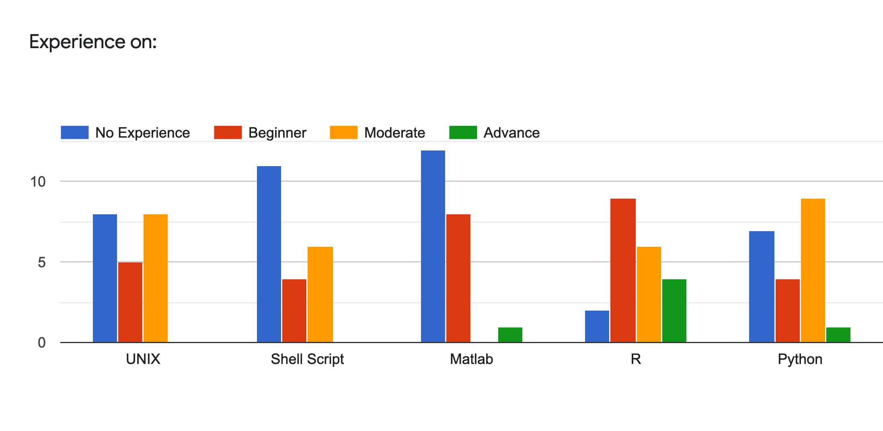
Programming Languages

Slide 11
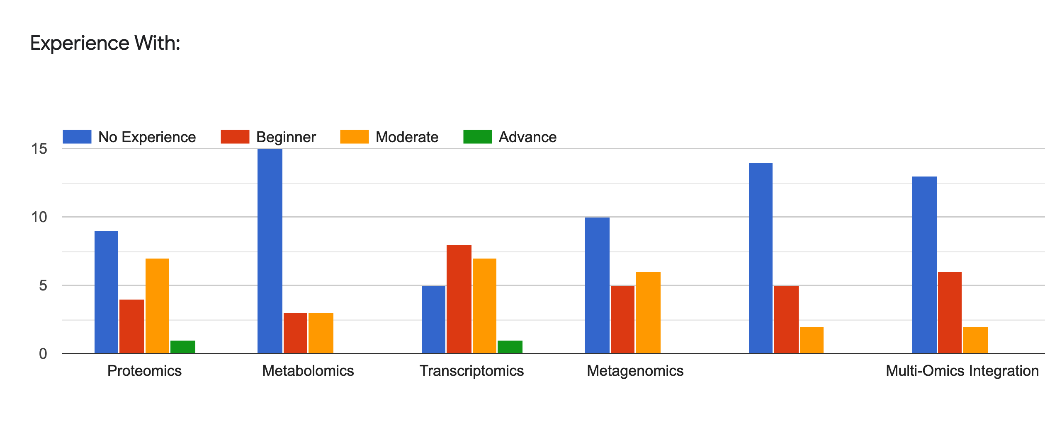
Omics and Integration

Slide 12
Questions? Problems?

Slide 13

Enjoy the course!!!

